Slide 1

Digital Sales Aid Architecture
http://bit.ly/dsachat
Marc Benioff
Chairman & CEO

Slide 2
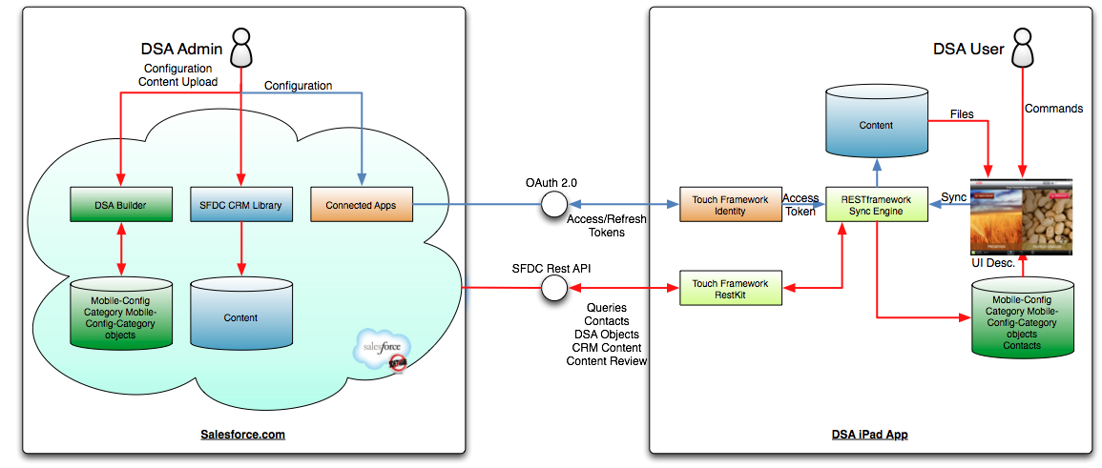
DSA System Architecture

Slide 3
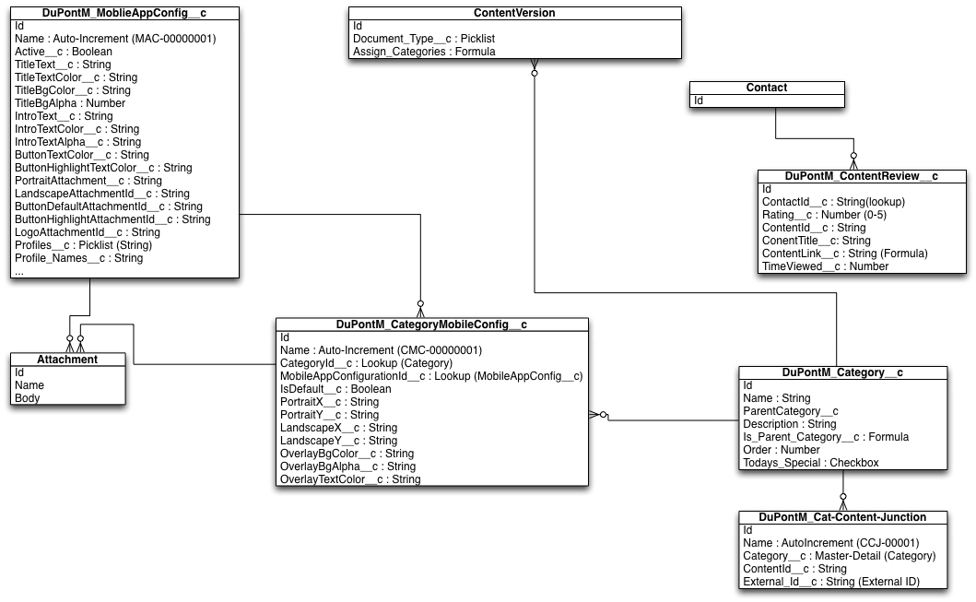
DSA Entity Relationship Diagram

Slide 4
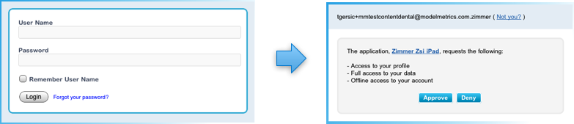
DSA Authentication/Authorization
The DSA App uses the Touch Identity Framework.
OAuth2.0 UI Patterns are used to Authenticate the user and obtain an Access Token with ID and API Scope.
MM_LoginViewController is used to implement the OAuth UI
The Touch Identity Framework handles the Access/Refresh token protocols for the DSA.
The Access Token is used for the REST calls

Slide 5
Design Patterns of the iOS App
The DSA App is based on the Model-View-Controller Design Pattern for the definition of its user interface.
Model:
CoreData database which contains the Salesforce Defined GUI Definition Objects and URI to the Downloaded Content
SFDC CRM Content
View:
Constructed from iOS View Classes: UITableView, UIScrollView
Controllers:
MM_BaseViewController: SyncControl, Login
MM_FlexibleVisualBrowser: Category Browsing
DSA_MediaDisplayViewController: Display Content Files

Slide 6
Design Patterns of the iOS App - 2
Synchronization (RESTframework).
Uses Touch Framework to access SFDC on behalf of the user using REST calls.
Initial Download of the Model and the Content
Populate the CoreData with Mobile_Config, Category_Mobile_Configuration, Category, Contact, etc. Objects
sync_objects.plist defines the objects to be synchronized and the synchronization strategy.
Populate CoreData with Content local URI
Download Content
Synchronization
Compare existing SFDC ID of the CoreData objects with those in SFDC to determine new, deleted and modified objects
Download Model
Download Content
DSA_MediaDisplayViewController: Display Content Files

Slide 7
Apple Accounts
Internal Employees
Apple Enterprise Certificate if deploying internally
Apple Dev Certificate if Deploying via App Store
External Partners
Apple Dev Certificate
Partners to have the Apple Volume Distribution Account

Slide 8
Graphical Checklist
APP IMAGES (in app build) | MAIN SCREEN (in Salesforce DSA config) | CATEGORY BACKGROUND (in Salesforce DSA config) | SUBCATEGORY ICON
App Initialization iPad3 2048 x 1496 landscape 1536 x 2008 portrait iPad2 1024 x 748 landscape 768 x 1004 portrait | Background iPad3 2048 x 1224 landscape 1536 x 1736 portrait iPad2 1024 x 612 landscape 768 x 868 portrait Buttons Large Enough to cover the Text | iPad3 1624 x 1224 landscape 1536 x 1246 portrait iPad2 812 x 612 landscape 768 x 623 portrait | 272 x 272 iPad3 136 x 136 iPad2
Bottom Menu Logo 300 x 58 iPad3 150 x 29 iPad2 | Top Menu Logo 300 x 58 iPad3 150 x 29 | Per category. | Per subcategory
App Icon 144 x 144 iPad3 72 x 72 iPad2

Slide 9
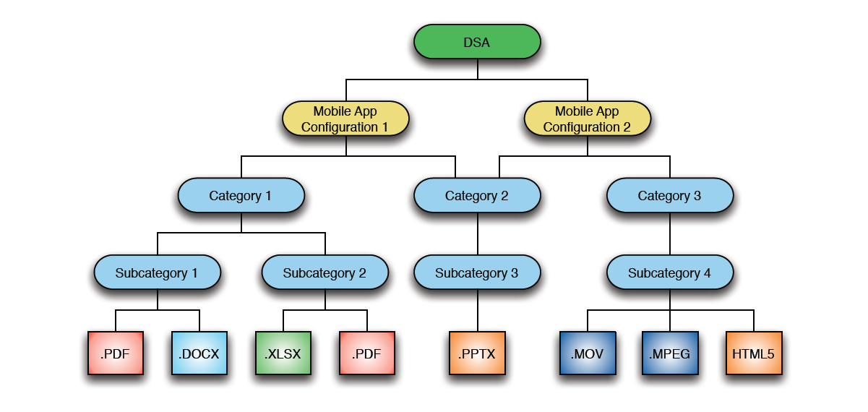
Content Hierarchy

Slide 10
Object Permissions
Category
Users must have at least read-only access to all fields
Mobile App Configuration
Users must have at least read only access to all configurations and fields
Category Mobile Configuration
Users must have at least read only access to all configurations and fields
Content Review
Users must have Write Access to this Object

Slide 11
Thank You

